Slide 1

Detecting Anomalous Insiders in Collaborative Information Systems
Team Members:
A.S.S.BHARADWAZA (11T81A0525)
T.NAVEEN KUMAR (11T81A0517)
P.SAI ARUN KUMAR (11T81A0528)
,
Under the guidance of
Mr. Ravinder Reddy, M.Tech,
Asst.professor,CSE Dept.

Slide 2
INTRODUCTION
COLLABORATIVE information systems (CISs) allow groups of users to communicate and cooperate over common tasks.
Additionally, hospitals have adopted Electronic Health Record (EHR) systems to decrease healthcare costs, strengthen care provider productivity, and increase patient safety, using vast quantities of personal medical data.

Slide 3
ABSTRACT
Record (EHR) system in a large medical center. The results illustrate our models exhibit significant performance gains over state-of-the-art competitors.
A number of Collaborative information systems (CISs) are deployed within a diverse array of environments that manage sensitive information.
Current security mechanisms detect insider threats, The Community Anomaly Detection System (CADS), an unsupervised learning framework to detect insider threats based on the access logs of collaborative environments.

Slide 4
Community Anomaly Detection System (CADS)
CADS consists of two components:
1) Relational pattern extraction, which derives community structures
2) Anomaly prediction, which leverages a statistical model to determine when users have sufficiently deviated from communities. We further extend CADS into MetaCADS to account for the semantics of subjects (e.g., patients’ diagnoses).

Slide 5
EXISTING SYSTEM
Supervised models consistently have a lower true positive rate at all operating points.
With respect to AUC, we observe the same trend as earlier regarding the dominance of the unsupervised models as a function of the mix rate.
CADS dominates only when the mix rate is high

Slide 6
PROPOSED SYSTEM
Proposed System Consistently Have a Higher True Positive Rate at All Operating Points
HVU(High volume users ) Achieves More Comparable Results When Compared To Supervised Models
MetaCADS dominates when the mix rate is low, but CADS dominates when the mix rate is high

Slide 7
SYSTEM REQUIREMENTS
Software Requirements:
OS :Windows XP with SP2 or Higher
Database :MS-SQL server 2008,Oracle
Language : C#.NET
IDE :Visual Studio .NET 2010 or Higher
Browser :IE or Google chrome
Hardware Requirements:
Processor :Pentium iv or higher
HDD :20 GB Min 40 GB Recommended
RAM :1 GB Min 2 GB Recommended

Slide 8
BLOCK DIAGRAM OF PROJECT PROCESS

Slide 9
MODULES
Pattern Extraction
Anomaly Detection
Detection Performance Metrics
Varying Number of Accessed Subjects

Slide 10
PATTERN EXTRACTION
CADS-PE infers communities from the relationships observed between users and subjects’ records in the CIS access logs. The community extraction process consists of two primary steps: a) construction of the user-subject access network and b) user community inference.
There are various aspects of a user’s relationship to subjects that could be leveraged for measuring similarity. To mitigate bias and develop a generic approach, we focus our attention on the number of subjects a user accessed

Slide 11
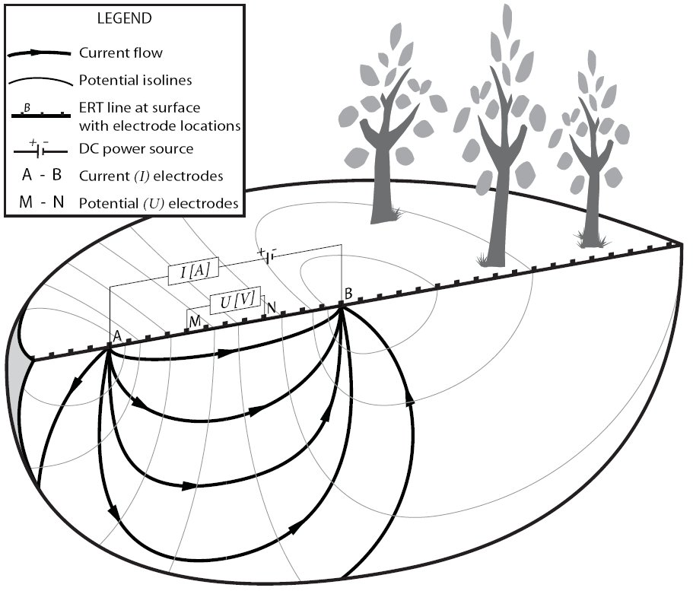

Slide 12
ANOMALY DETECTION
CADS-AD predicts which users in the CIS are anomalous by e) discovering a user’s nearest neighbors and f) calculating the deviation of each user from their neighbors.
There are alternative anomaly detection models that have been proposed in the literature. Thus, in addition to CADS and MetaCADS, we evaluate three of the most related models. The first two are based on supervised classification and assume there exists a training set of anomalous and
no anomalous user class labels, whereas the final model is an unsupervised heuristic. For each of these models, we treat real and simulated users as no anomalous and anomalous, respectively.

Slide 13
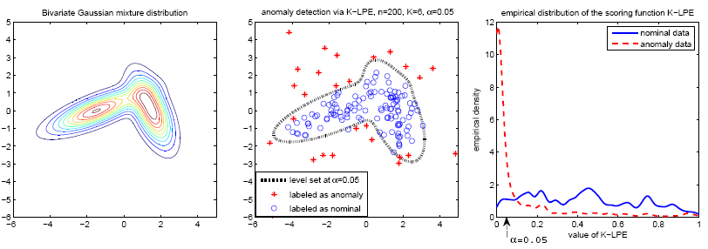

Slide 14
DETECTION PERFORMANCE METRICS
We measure the performance of the models using the Receiver Operating Characteristic (ROC) curve.
This is a plot of the true positive rate versus false positive rate for a binary classifier as its discrimination threshold is varied.
The Area Under the ROC Curve (AUC) reflects the relationship between sensitivity and specificity for a given test.
A higher AUC indicates better overall performance. In the final two simulation settings, we report on the average AUC per simulation configuration.

Slide 15
VARYING NUMBER OF ACCESSED SUBJECTS
The first set of experiments focus on the sensitivity of anomaly detection models. To begin, we mixed a single simulated user with the real users.
We varied the number of subjects accessed by the simulated user to investigate how volume impacts the deviation score and the performance of the anomaly detection models in general.

Slide 16
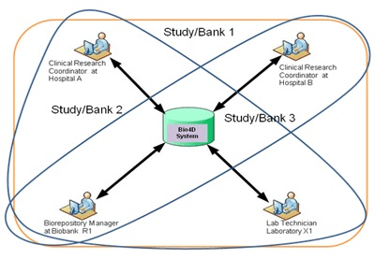

Slide 17


RESULTS-SCREEN SHOTS

Slide 18
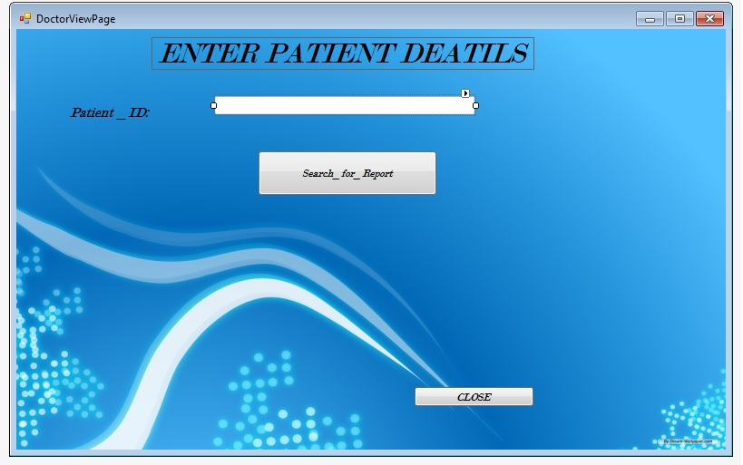


Slide 19
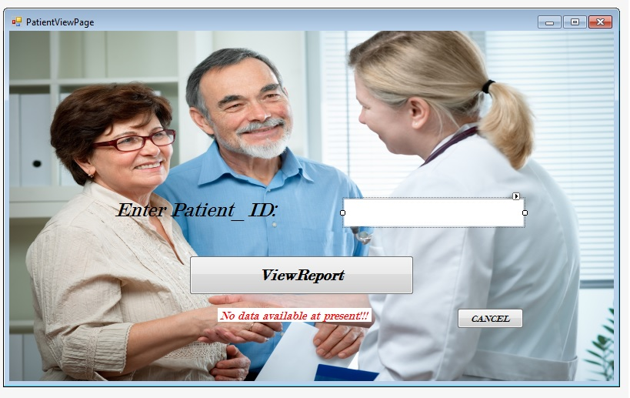

Slide 20

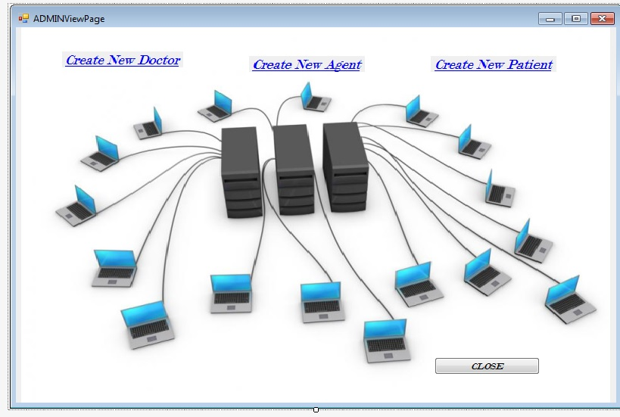

Slide 21
CONCLUSION
To detect anomalous insiders in a CIS, we proposed CADS, that utilizes a relational framework. To predict which users are anomalous, CADS calculates the deviation of users based on their nearest neighbor networks.
We further extended CADS into MetaCADS to incarnate the semantics of the subjects accessed by the users.
Our model is based on the observation that “normal” users tend to form communities, unlike illicit insiders.
Our results illustrated that the community-based models exhibited better performance at detecting simulated insider threats.
The evidence further suggested that MetaCADS is the best model when the number of intruders is relatively small, but that CADS dominates when the number of intruders increases.

Slide 22

THANK YOU!! PRESENTED BY: A.S.S.BHARADWAZA (11T81A0525) T.NAVEEN KUMAR (11T81A0517) P.SAI ARUN KUMAR (11T81A0528)

